Slide 1
Peter’s Portfolio Presentation

Slide 2
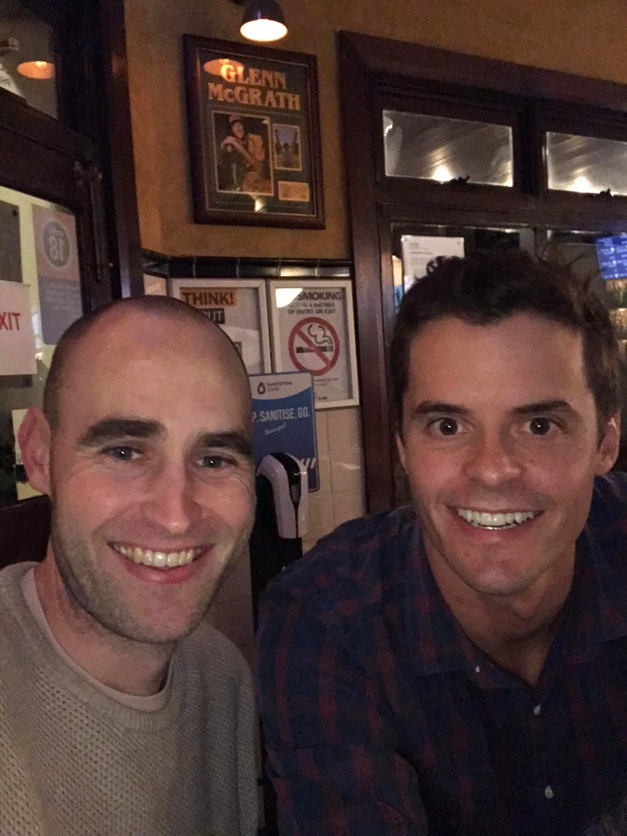
Hello!
I am Peter Lynch
I am here because I love to give presentations.
You can at me @thelynchpinau

Slide 3
Website Structure
R7
The Easy part right

Slide 4
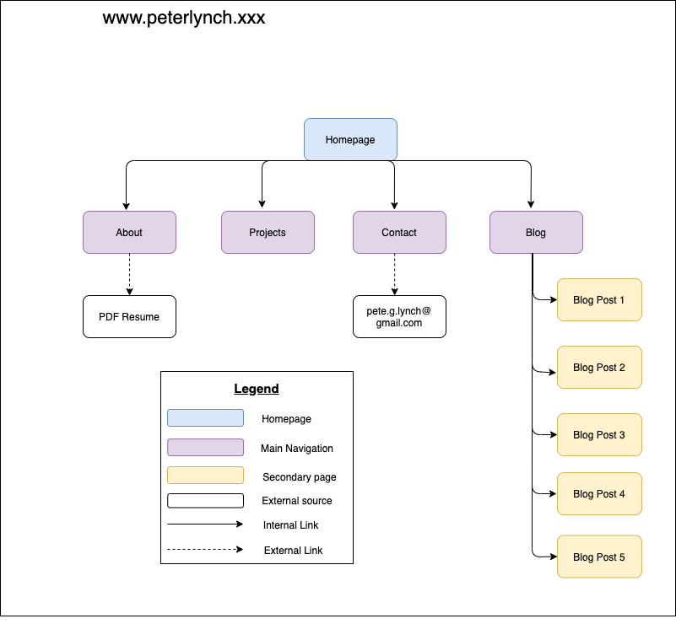
Site Map
Homepage icon will allow users to navigate back from all other pages.
Next 4 key level 2 pages that will be on Nav bar.
Blog Posts will flow from Blog Page.
You can navigate to any Lvl 1 and Lvl 2 level pages from any page on site using Navbar.
Place your screenshot here

Slide 5
Wireframes
R8
The decision making process

Slide 6
OVERALL DESIGN
SET OUT TO HAVE MINIMALIST AESTHETIC
I TRIED TO IMAGINE I WAS A HIRING MANAGER WHAT THINGS WOULD I WANT TO SEE
LED TO WANTING TO CREATE NAV PAGES (ABOUT, PROJECTS, BLOG)
ORIGINALLY WAS GOING TO HAVE BASIC TWO COLORS USED THROUGHOUT THE SITE
ENDED UP WITH GAMING THEME TO SHOW ROOTS
RESPONSIVE DESIGN, SOME PERSONALITY AND FLAIR
HERE IS WHERE I WOULD SHOW SOME CODING SKILLZ
USED SNES CONTROLLER AS INSPIRATION TO STYLE

Slide 7
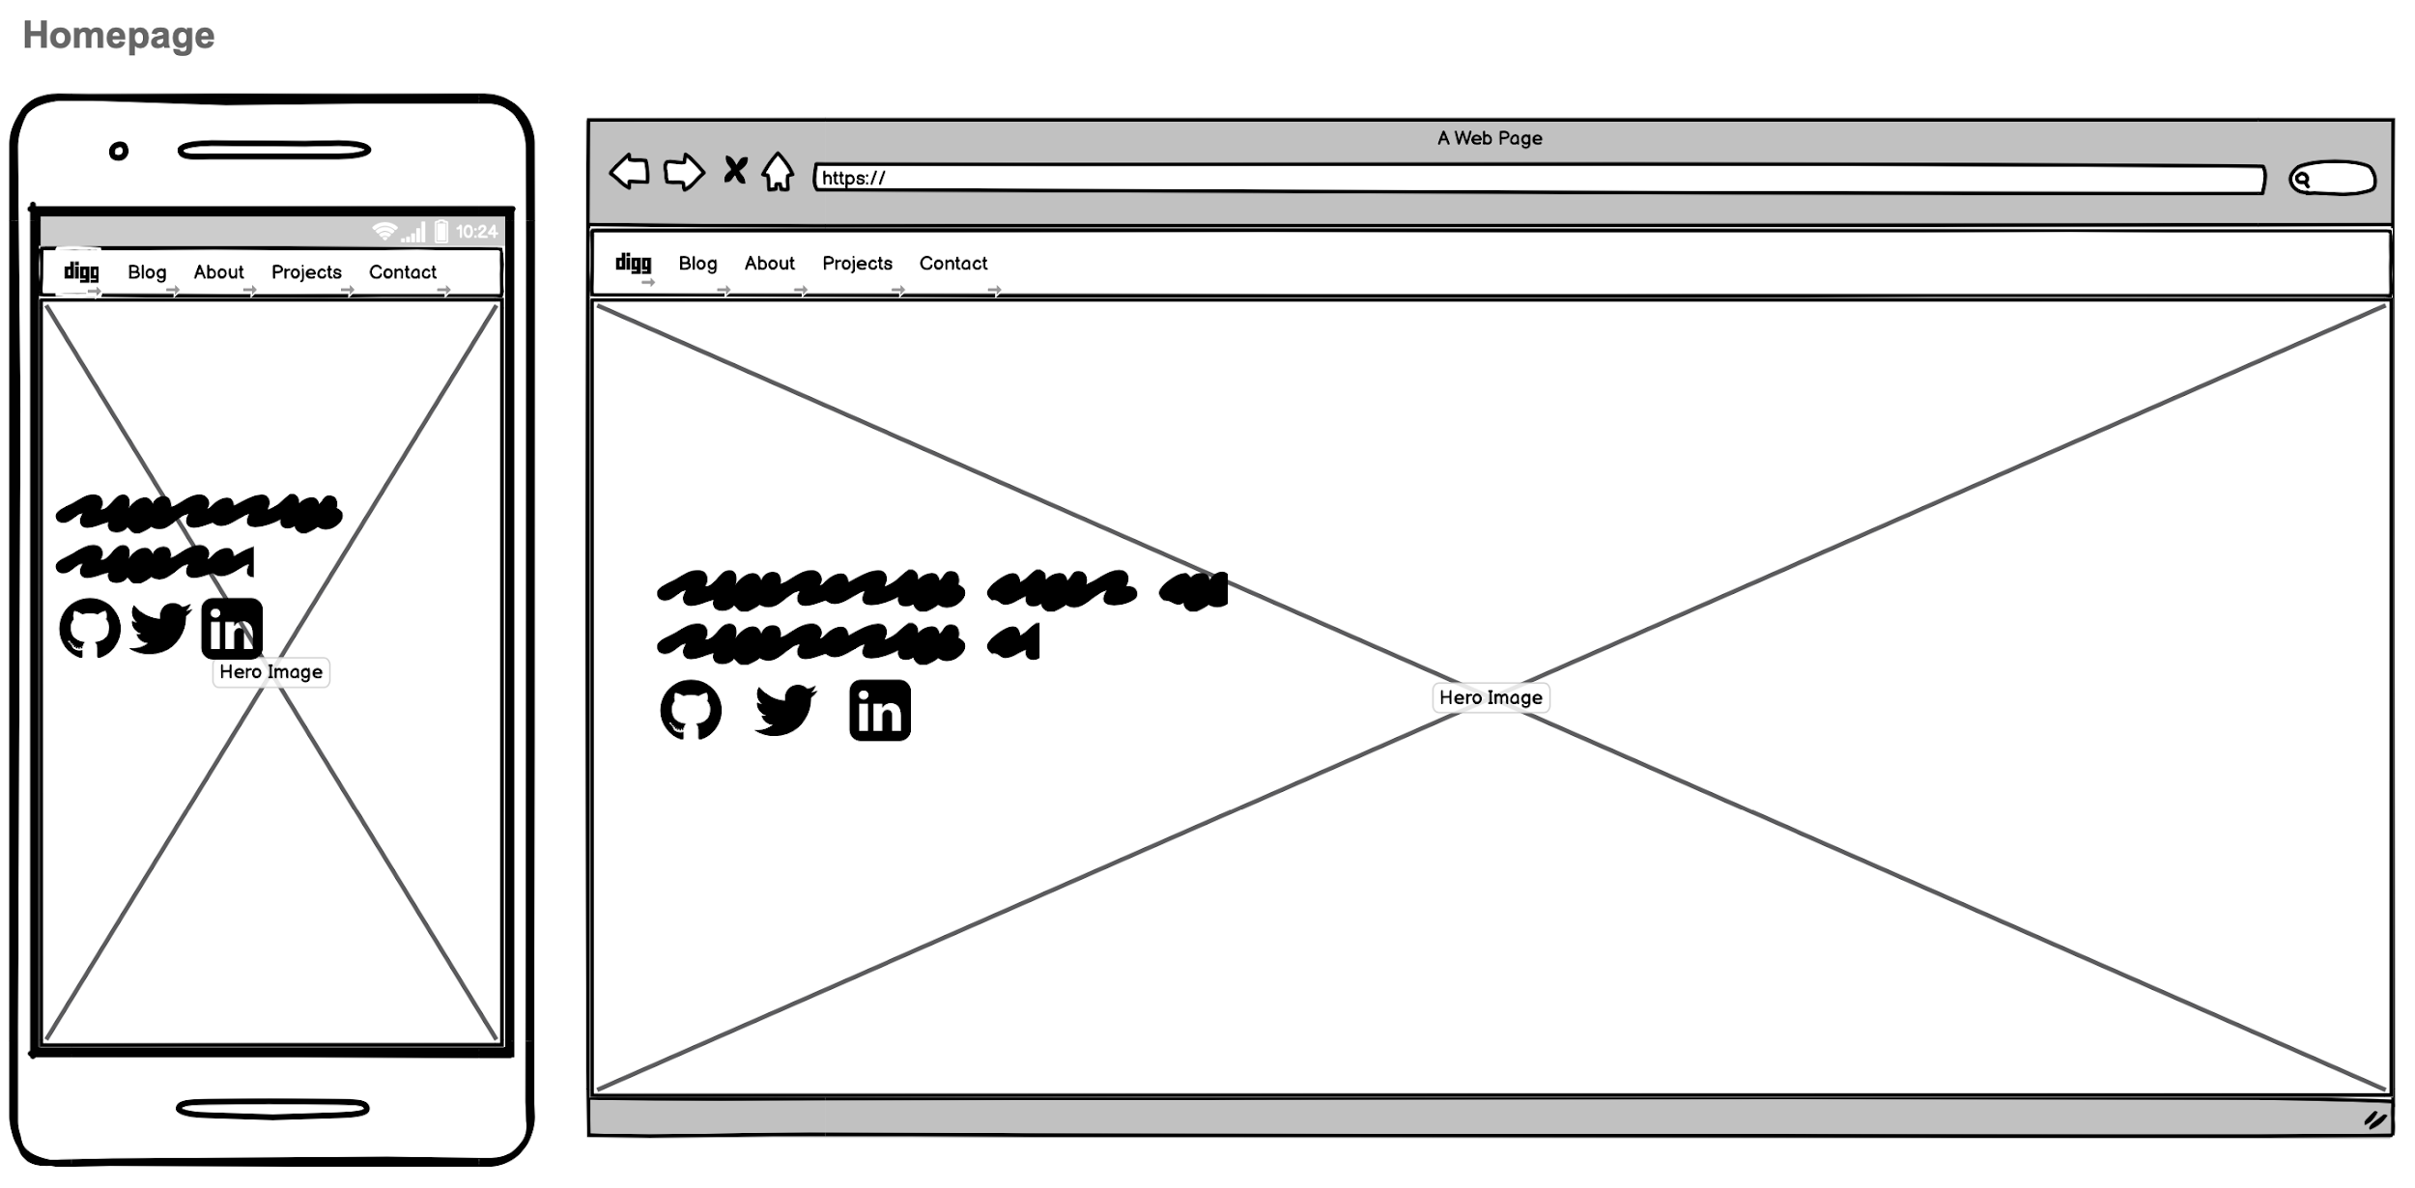
HOMEPAGE
Clean simple landing page
Wanted person viewing the site to know straight away who I am
Save the raz-a-ma-taz for sections I wanted to show more personality

Slide 8
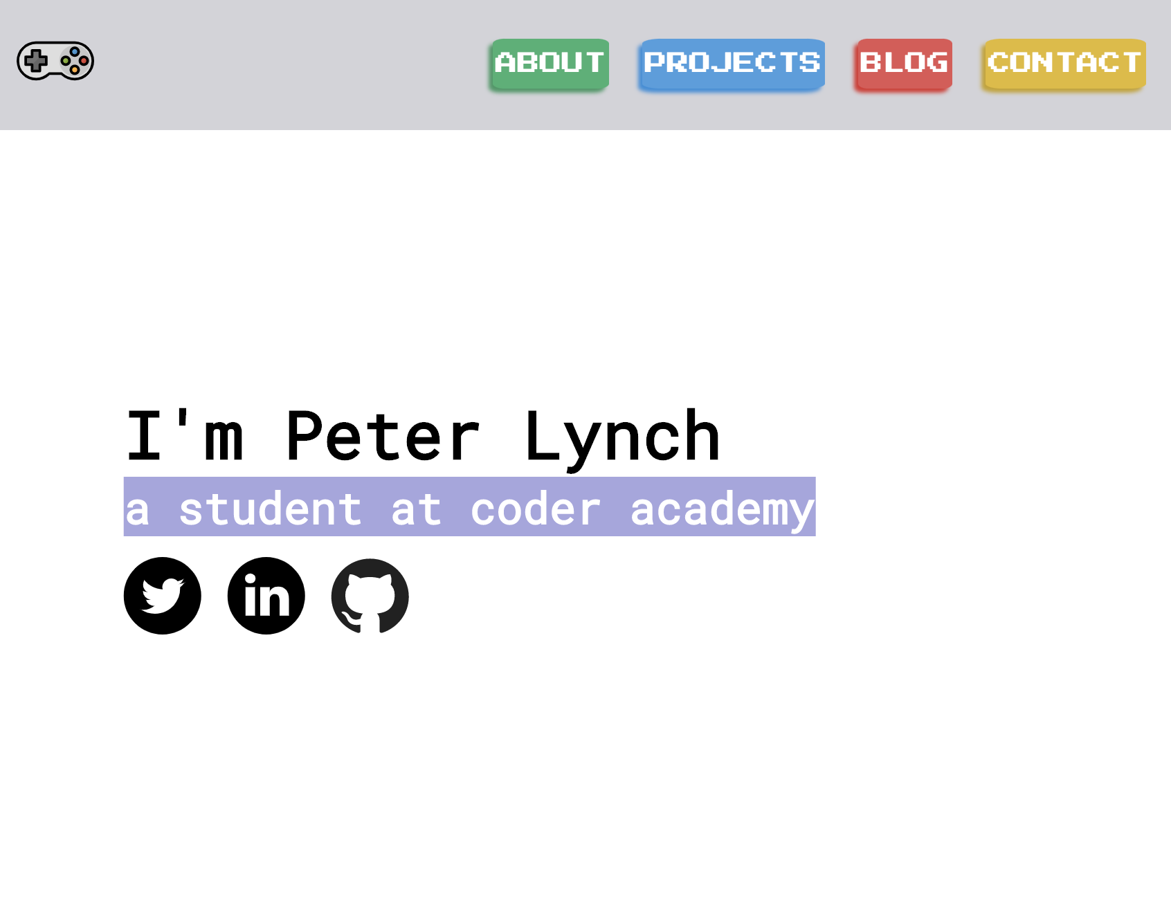
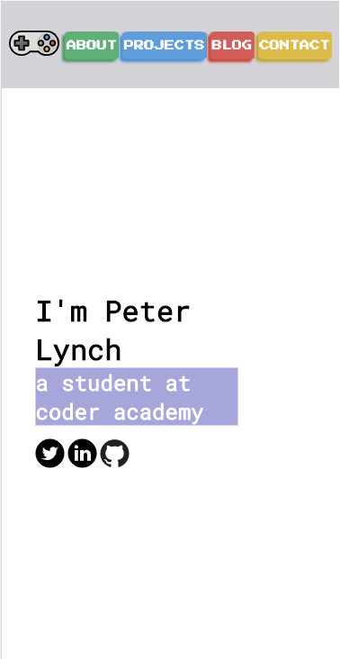
HOMEPAGE

Slide 9
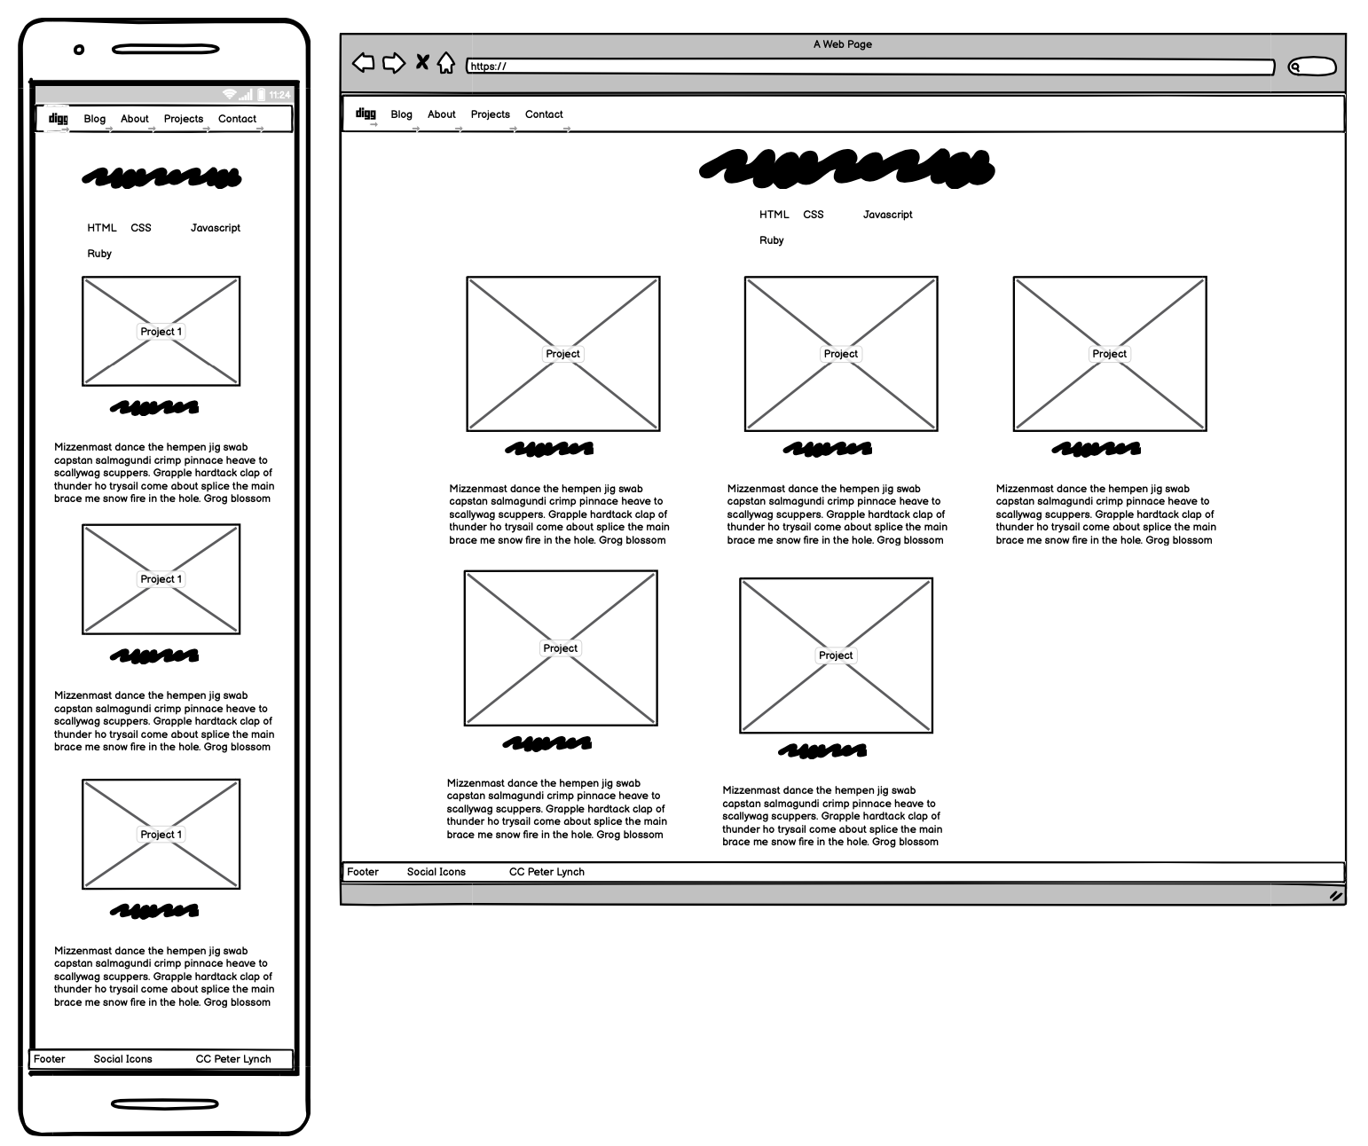
PROJECTS-WIREFRAME
Mobile first with Flex and so it could convert to row layout for desktop
Wanted to be visual first, followed by quick description and link to project.

Slide 10
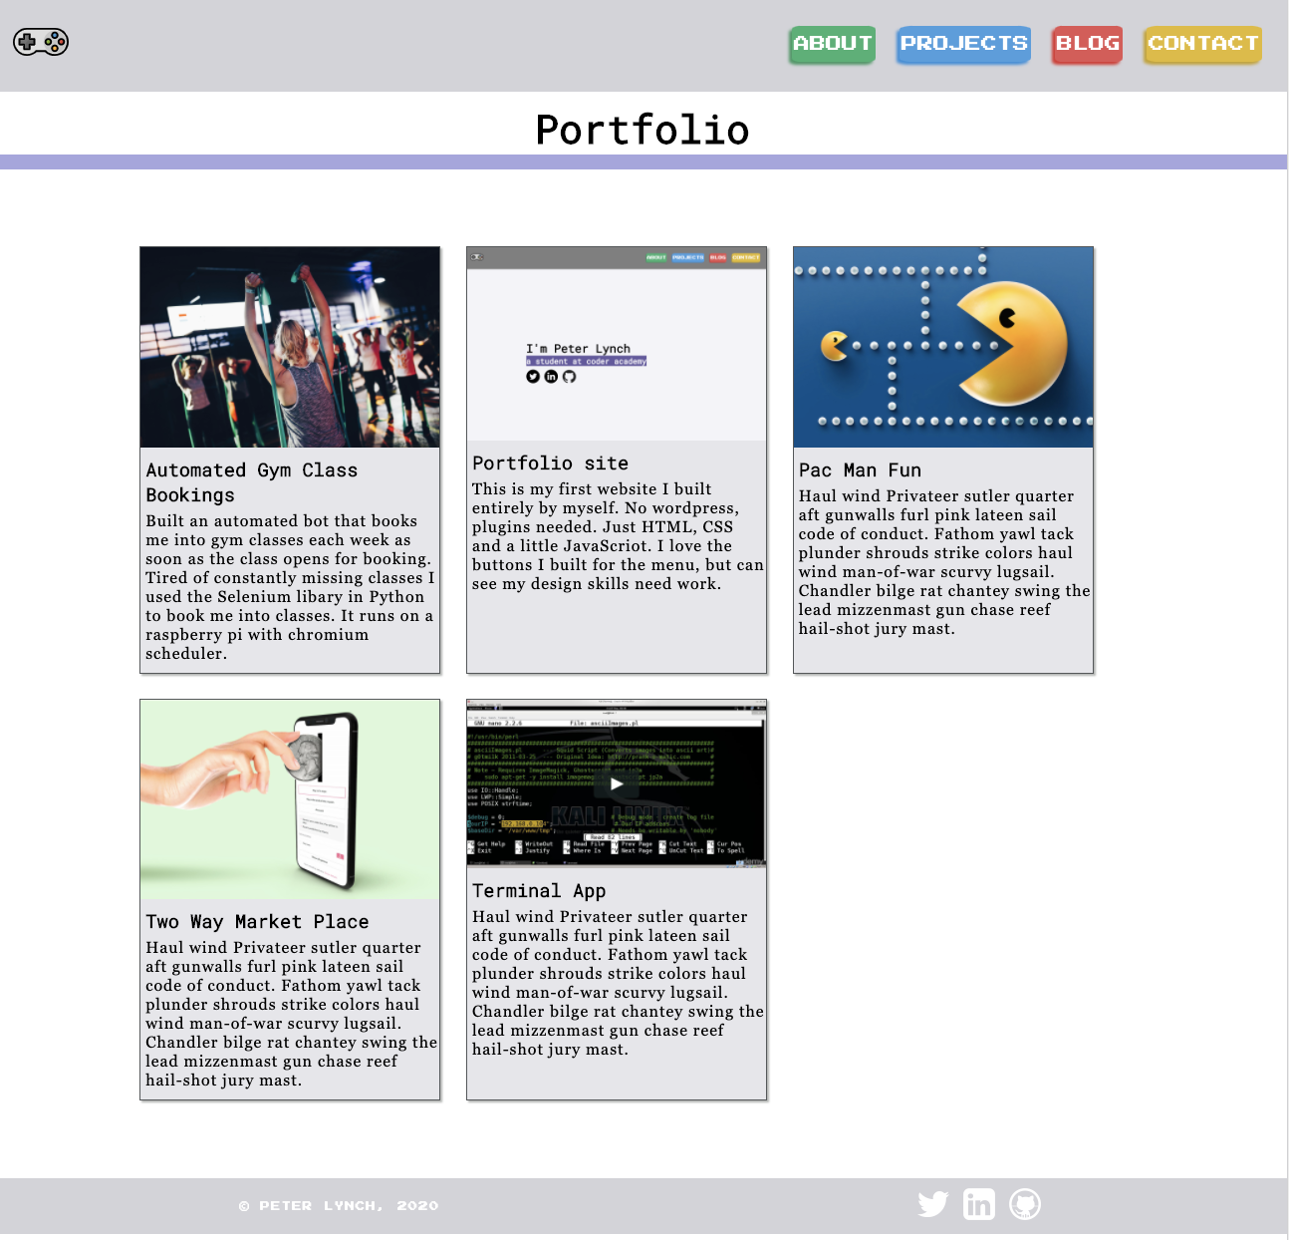
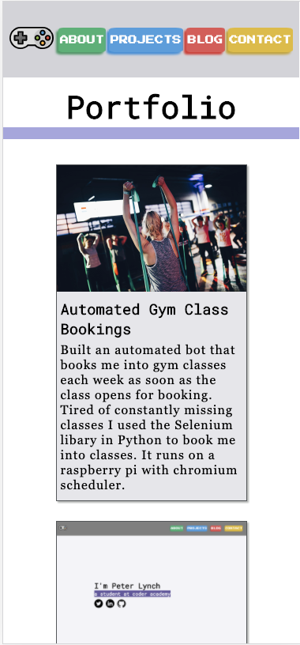
PROJECTS-WIREFRAME

Slide 11
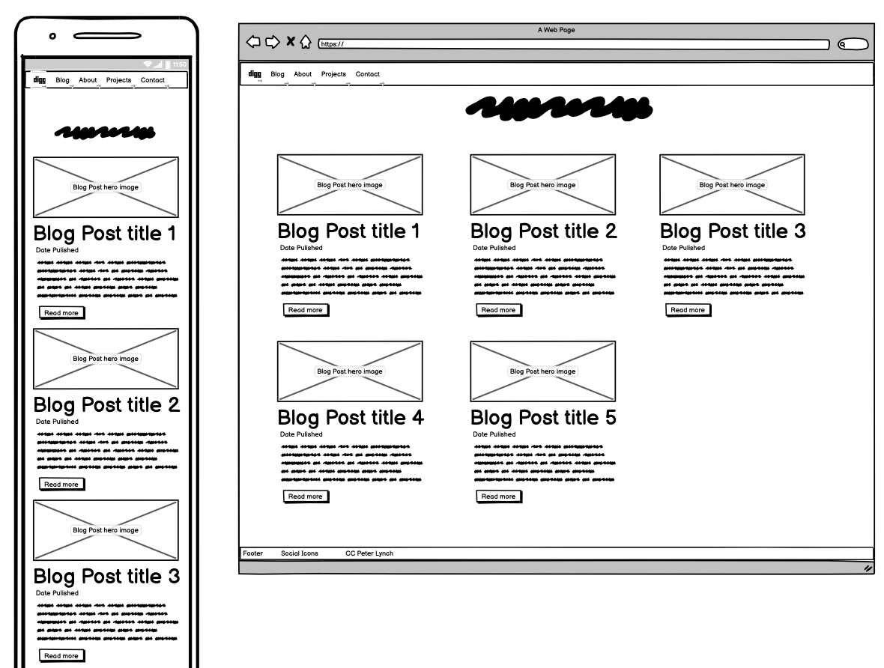
BLOG-WIREFRAME
Utilise Flex to make mobile and desktop
Visual first - then heading
Include small snippets of general gist of post
Offer a read more button

Slide 12
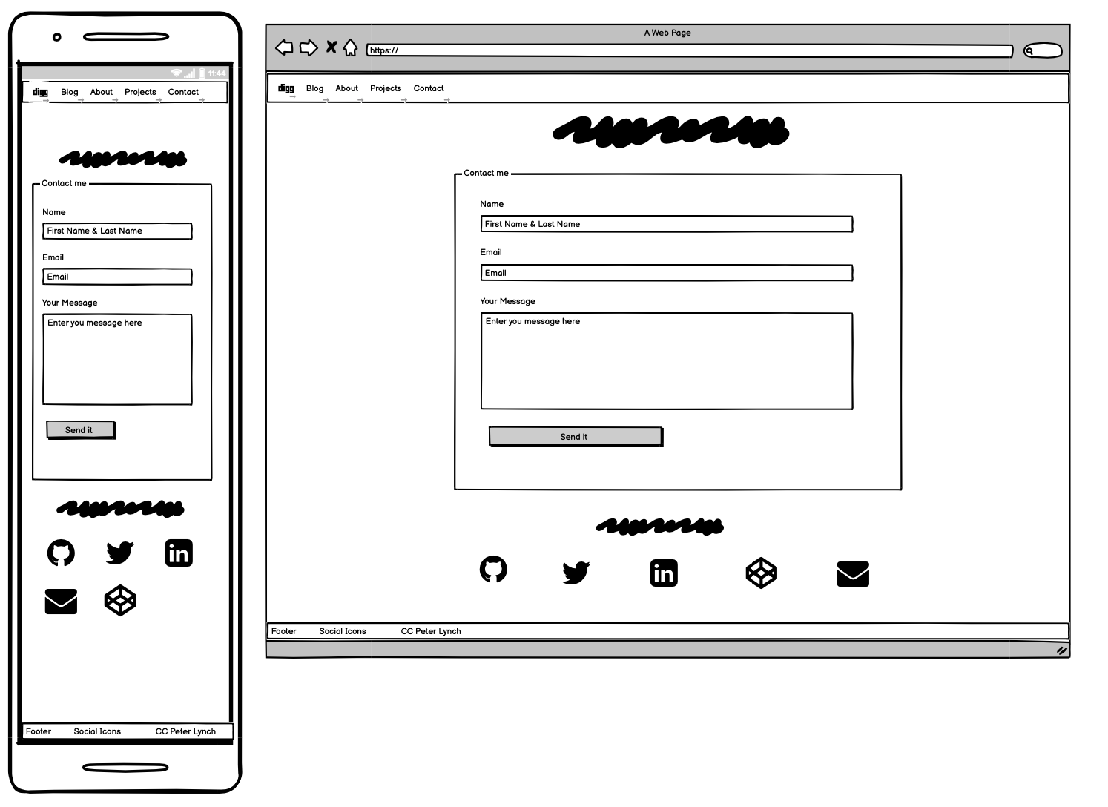
CONTACT-WIREFRAME
Clear call to action on this page
“hit me back just to chat, if your my biggest fan stan”
Offer other avenues for people to slide into my DM’s

Slide 13
Why the changes
I think a lot of what you saw you got from the WF
I wanted to show more of my personality and to let you learn more about my skills.
I think a lot of my target audience would relate with the retro design and potentially feel familiarity and nostalgia.
Exploration changed me man.

Slide 14
Styling Elements
Theme: I had no idea. I went picked my icon and grew from there. I wanted to be clean and minimal.
Style: The mullet site.
Font: Nav and appropriate elements vs. readability
Cards: Clean lines to draw the eyes, then lit 🔥 animations to get them to click.
About page: Wanted mix of visual and text. Slide element and emojis aim to show some of my humour and personality.

Slide 15
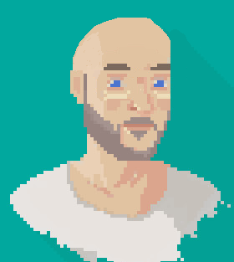
Thanks Folks
I learnt heaps from my first attempt at building a website from scratch. I had a ball. I hope you enjoyed my presentation nearly half as much as I did making it.

